Slide 1
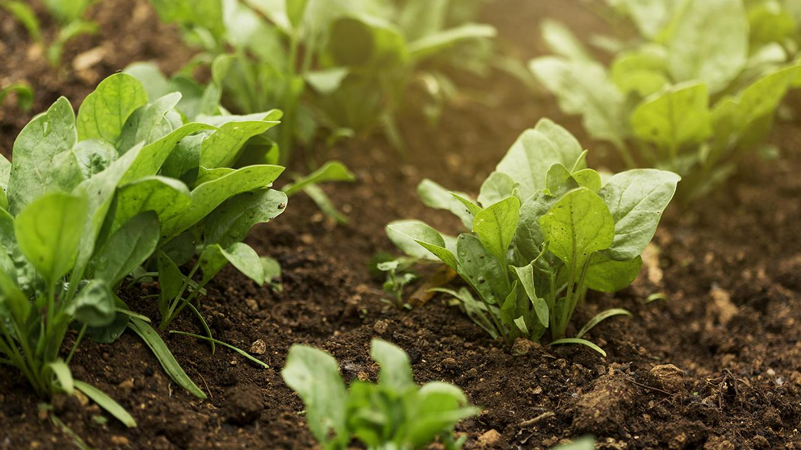
Crop and Weed Detection
Machine Vision in Precision Agriculture
By Andrew Boucher

Slide 2
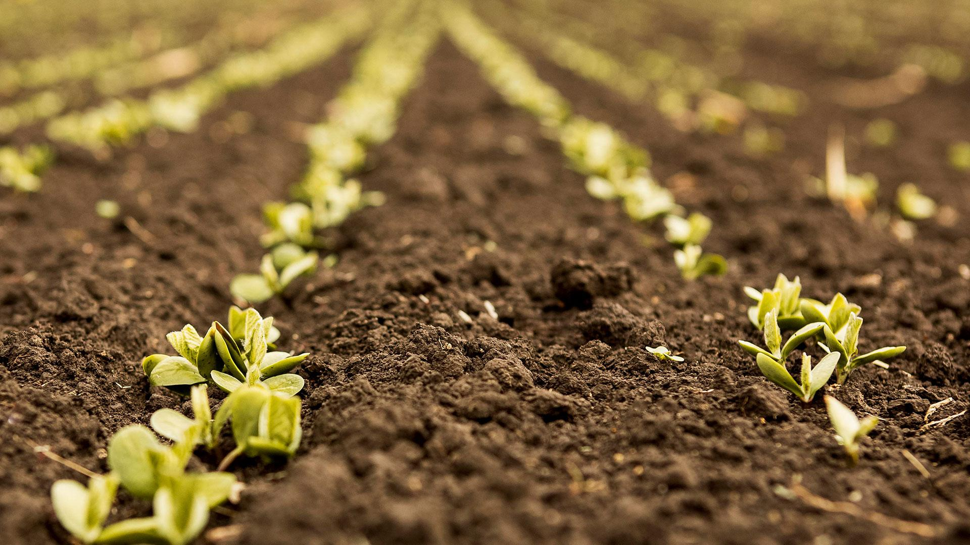
Overview
Business Problem
Project Goal
Data
Modeling
Results
Conclusions
Next Steps

Slide 3
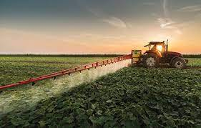
Business Problem
Problem
Weeds → Reduce Crop Production
Broadcast Spray Herbicides
Human & Planet’s Health
$$$
Solution
Reduce Herbicide Use: Precision Agriculture
Robotics
Machine Vision

Slide 4
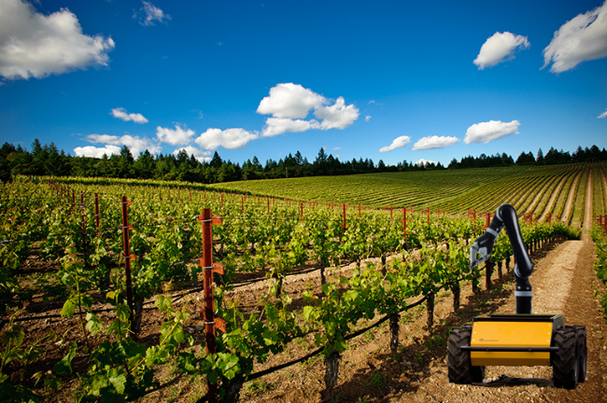
Project Goal
CNN Object Detection Model
Crops & Weeds
Classification
Location
Selective Spraying

Slide 5
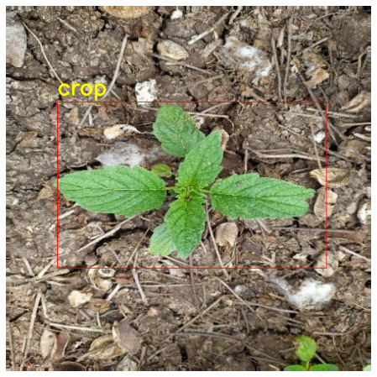
Data
Kaggle Dataset
546 Images Augmented to 1300
Sesame Crop
Weed
Annotations in YOLO format
Labels
Bounding Boxes

Slide 6
Modeling - Structure
Backbone
Class Label Head
Bounding Box Head
Class Label Predictions
Bounding Box Predictions
7 Keras Models
Weights Pretrained on Imagenet Dataset
1 Custom Model
Trained on Crop and Weed Dataset
7 Class/Bbox Head Iterations
Trained on Crop and Weed Dataset

Slide 7
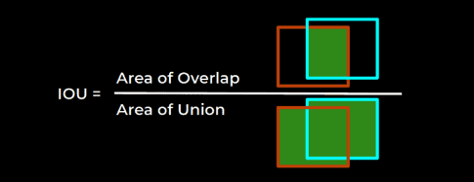
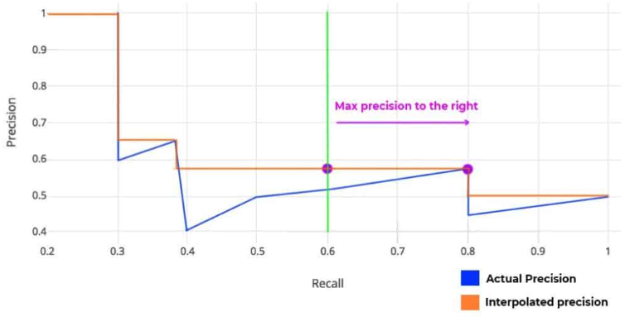
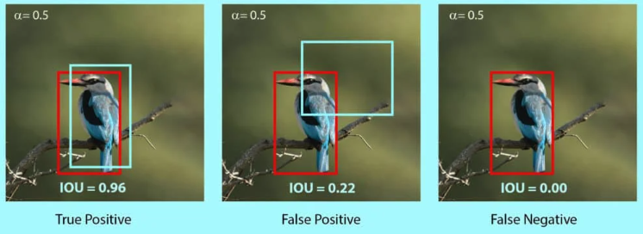
Modeling - Metrics
Intersection over Union
Mean Average Precision
Area of Intersection
Ground Truth Area + Predicted Box Area - Area of Intersection
AP = Area Under Precision/Recall curve for each Class
mAP = Sum of AP for all Classes / Total # of Classes
COCO mAP = Average mAP @ 10 IoU Thresholds
From 0.5 - 0.95 (0.05 step)
All images taken from https://learnopencv.com

Slide 8
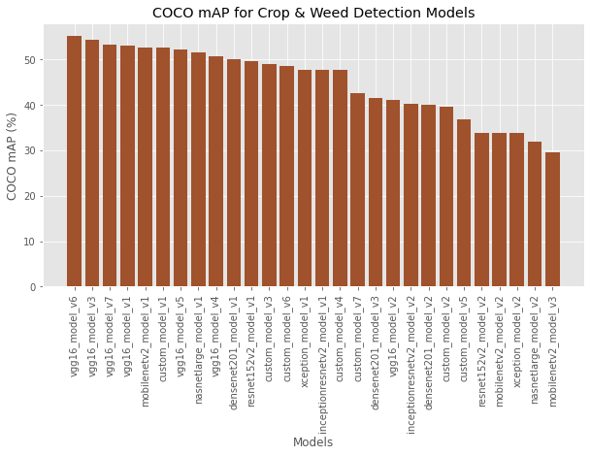
Results - COCO mAP
Best Model

Slide 9
Results - COCO mAP
Best COCO mAP Model Structure
Backbone:
VGG16
Class Label Head V6:
Dense(256, activation="relu")
Dropout(0.5)
Dense(128, activation="relu")
Dropout(0.5)
Dense(2, activation="sigmoid")
Bounding Box Head V6:
Dense(256, activation="relu")
Dense(128, activation="relu")
Dense(64, activation="relu")
Dense(132, activation="relu")
Dense(4, activation="sigmoid")
COCO mAP: 55.3%

Slide 10
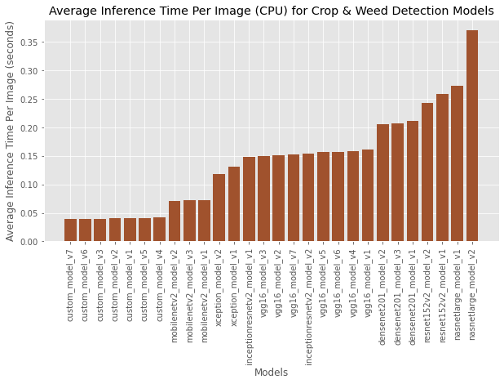
Results - Inference Time
Best Model

Slide 11
Results - Inference Time
Best Inference Time Model Structure
Custom Backbone:
Conv2D(32, (3,3),activation='relu')
MaxPool2D(pool_size=(2, 2))
Conv2D(64, (3,3), activation='relu')
MaxPool2D(pool_size=(2, 2))
Conv2D(128, (3,3), activation='relu')
MaxPool2D(pool_size=(2, 2)
Conv2D(256, (3,3), activation='relu')
MaxPool2D(pool_size=(2, 2))
Conv2D(512, (3,3), activation='relu')
MaxPool2D(pool_size=(2, 2))
Class Label Head V7:
Dense(128, activation="relu")
Dropout(0.5)
Dense(64, activation="relu")
Dropout(0.5)
Dense(2, activation="sigmoid")
Bounding Box Head V7:
Dense(128, activation="relu")
Dropout(0.5)
Dense(64, activation="relu")
Dense(132, activation="relu")
Dense(4, activation="sigmoid")
Inference Time: 0.039s

Slide 12
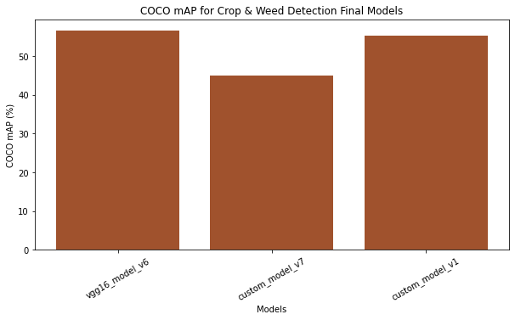
Conclusions
 | Backbone | Class Label Head | Bbox Head | COCO mAP (%) | Inference Time (s)
mAP: Best Model | VGG16 | V6 | V6 | 56.7 | 0.164
Inference Time: Best Model | Custom | V7 | V7 | 44.9 | 0.035
mAP: Best Custom Model | Custom | V1 | V1 | 55.3 | 0.036

Slide 13
Next Steps
Model Improvement → More Data
Model Improvement → Different Pretrained Models (YOLO, RCNN)
Model Improvement → Fine Tuning (retrain entire model)
Apply model to pest infestations

Slide 14
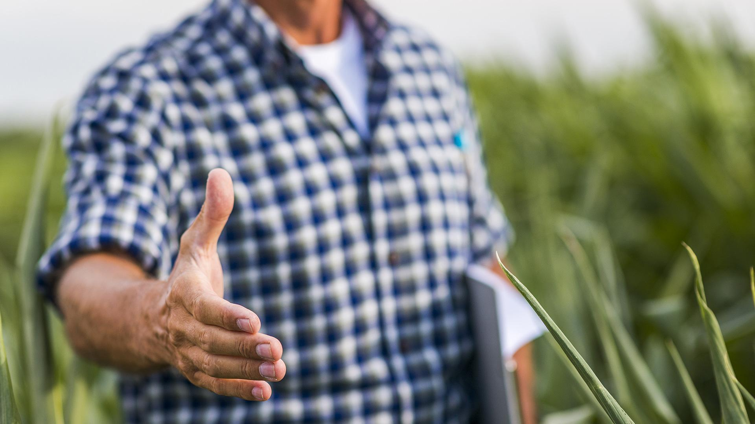
Thank you!
For Questions Contact: Andrew Boucher
Email: andrew.leo.boucher@gmail.com
Github: Andrew-Boucher

